Slide 1
IOT BASED SMART CAR-PARKING SYSTEM
PRESENTED BY: GUIDED BY:
NAINA AGGARWAL DR.RADHA GUHA
KANIKA SINGHAL PROF. CSE DEPT.
RIDHIMA GUPTA
RASHI

Slide 2
SMART CAR PARKING SYSTEM
The proposed smart car parking system will overcome all the challenges and difficulties that are there in the conventional car-parking system.
It saves us the time and effort that we put into this task, and also the fuel wastage can be reduced.
Smart car parking system will be a revolutionary change in the city life, which is so filled with automobiles.
It could help bring order out of the chaos that exists at present in the car parking issue and make it really simple and easy.

Slide 3
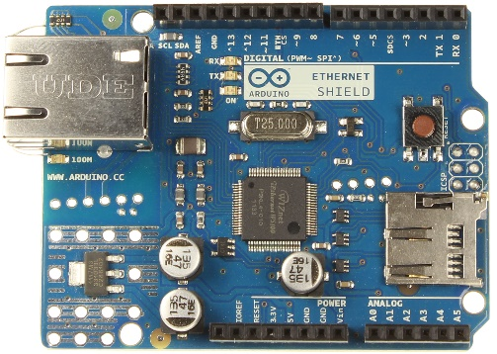
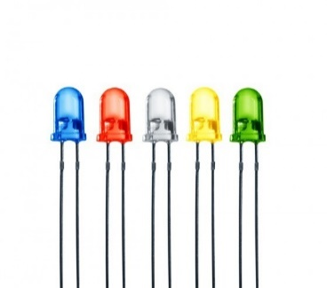
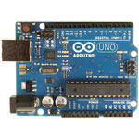
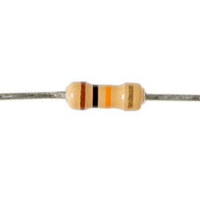

MATERIALS REQUIRED
Microcontroller (Arduino Uno )
Arduino Ethernet Shield
IR Sensors
LEDs
10k ohms Resistor
Cloud Storage
Software requirements as follows:
- Arduino Development Environment
- Android Studio (Android IDE)

Slide 4
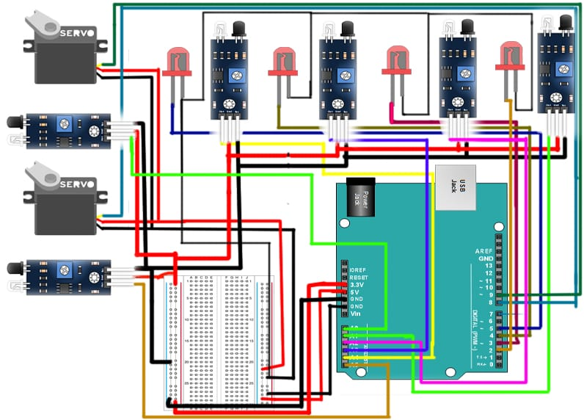
CIRCUIT DIAGRAM

Slide 5
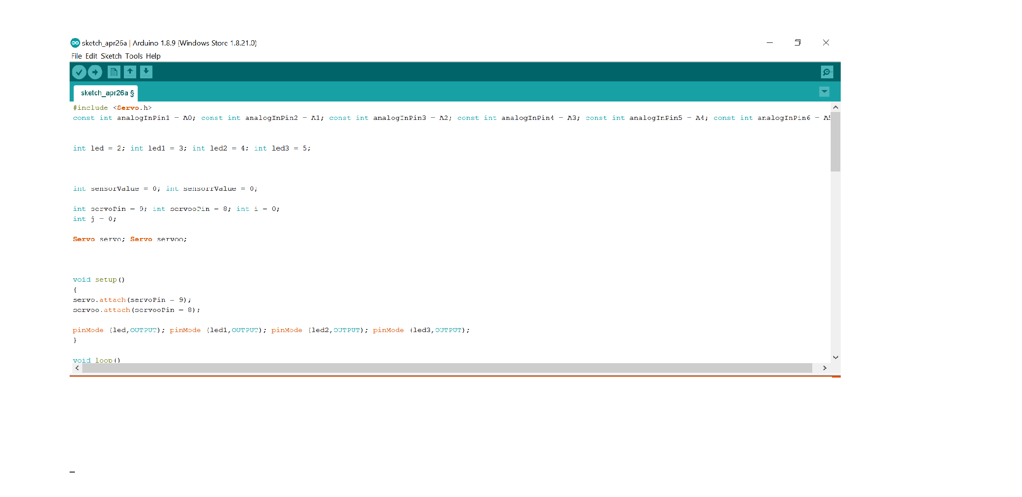
ARDUINO PROGRAMMING

Slide 6
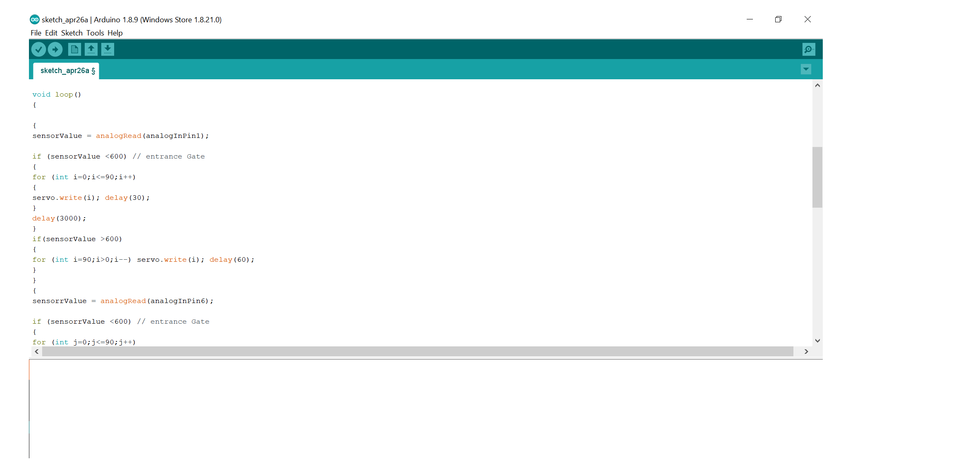

Slide 7
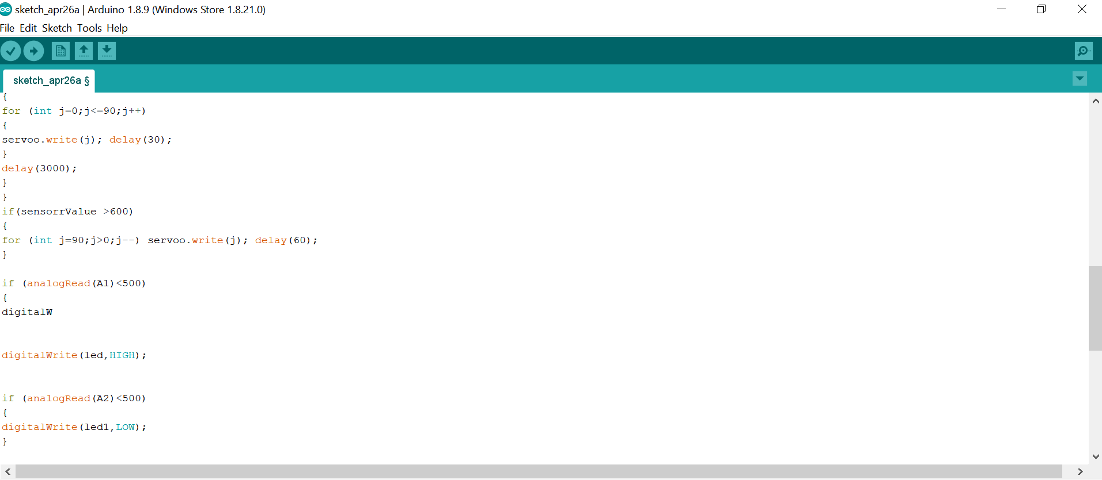

Slide 8
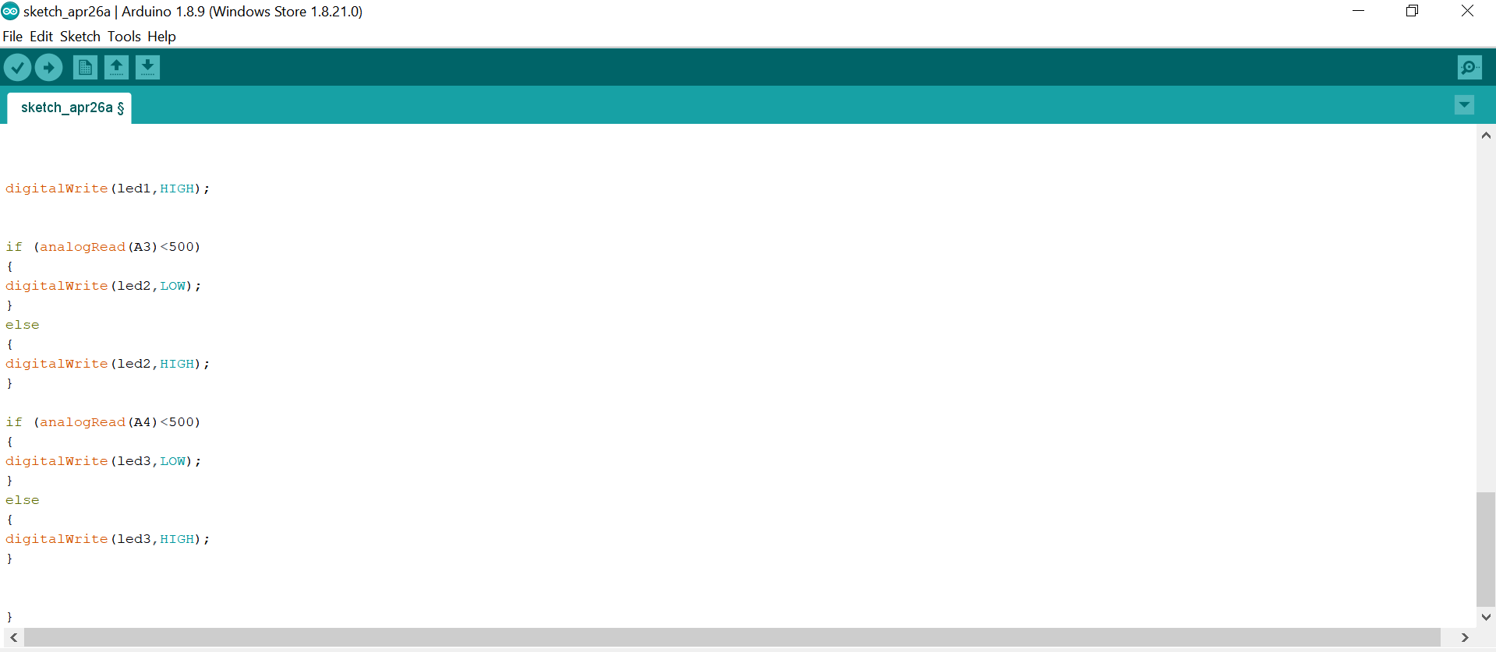

Slide 9
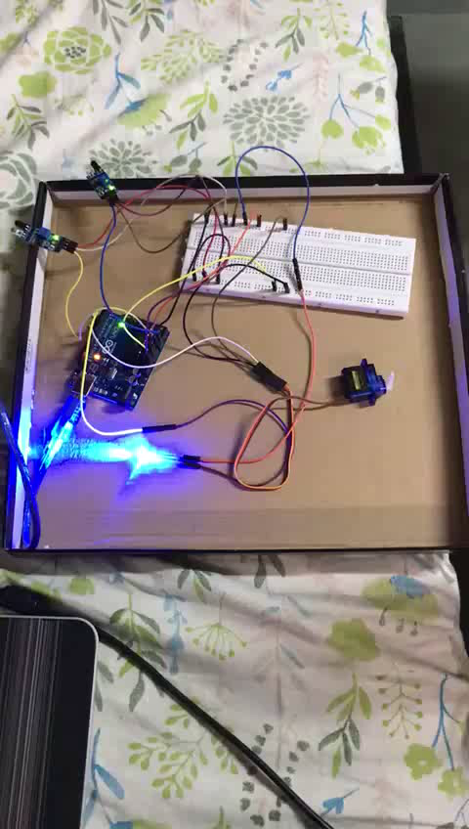
WORKING MODEL

Slide 10

LOGIN FORM

Slide 11
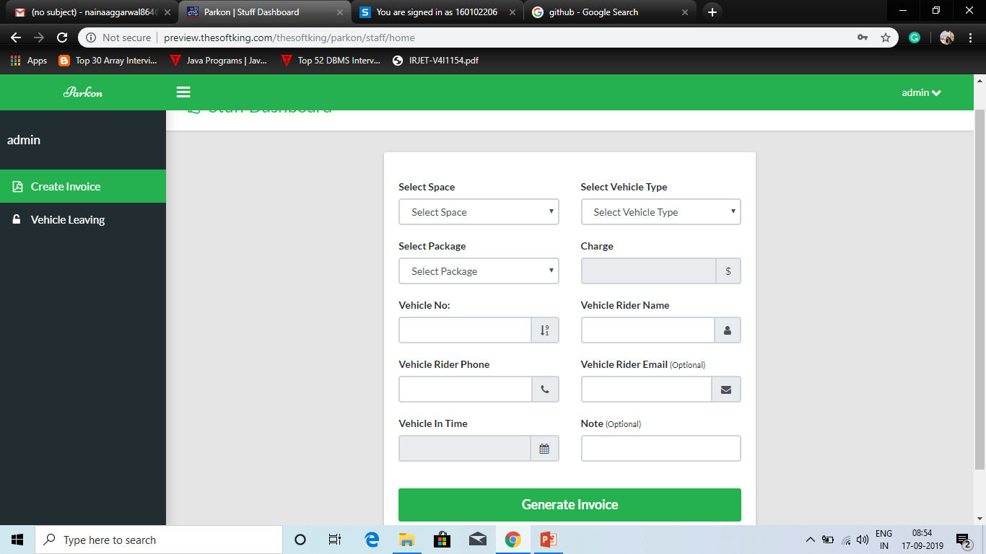
CREATE INVOICE FORM

Slide 12
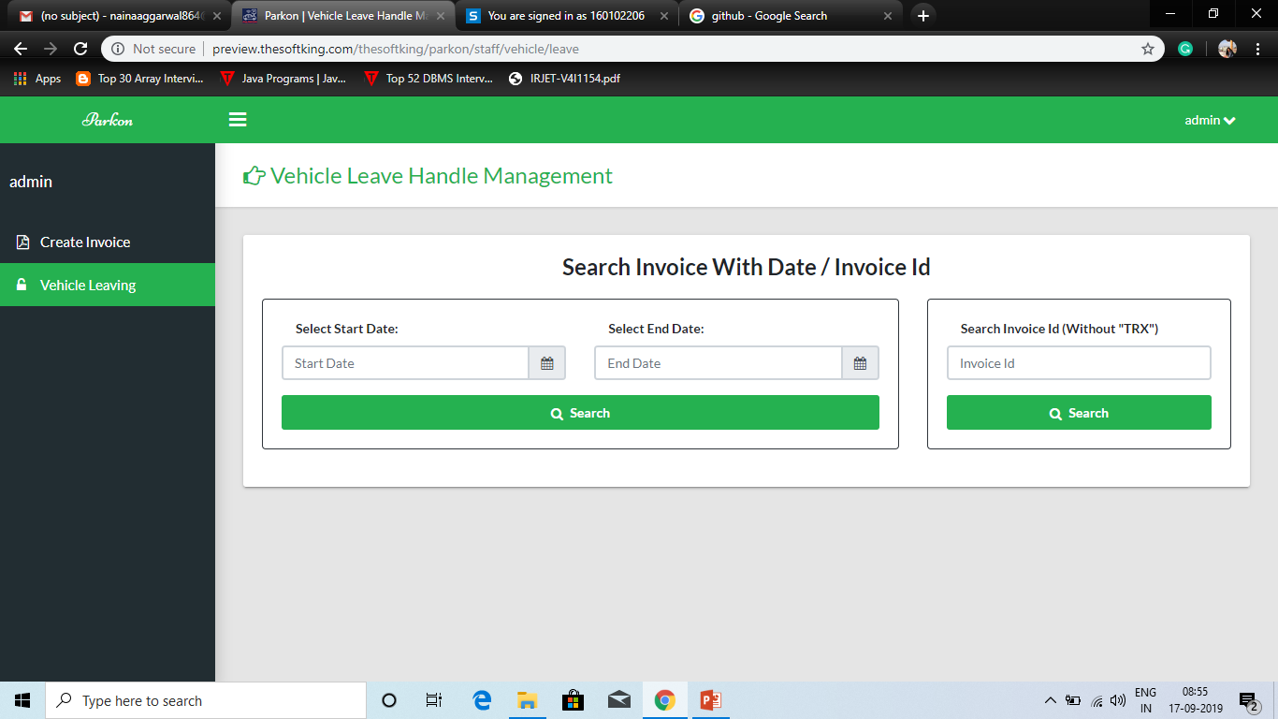
VEHICLE LEAVING FORM

Slide 13
THANK YOU

